Slide 1

ASM PROJECT PRESENTATION
Presented by
Nick Dahms, Josh Jolly, Tayler Silacci, Brandon Varao
Store: 3587, Market: 455, Region: 56

Slide 2
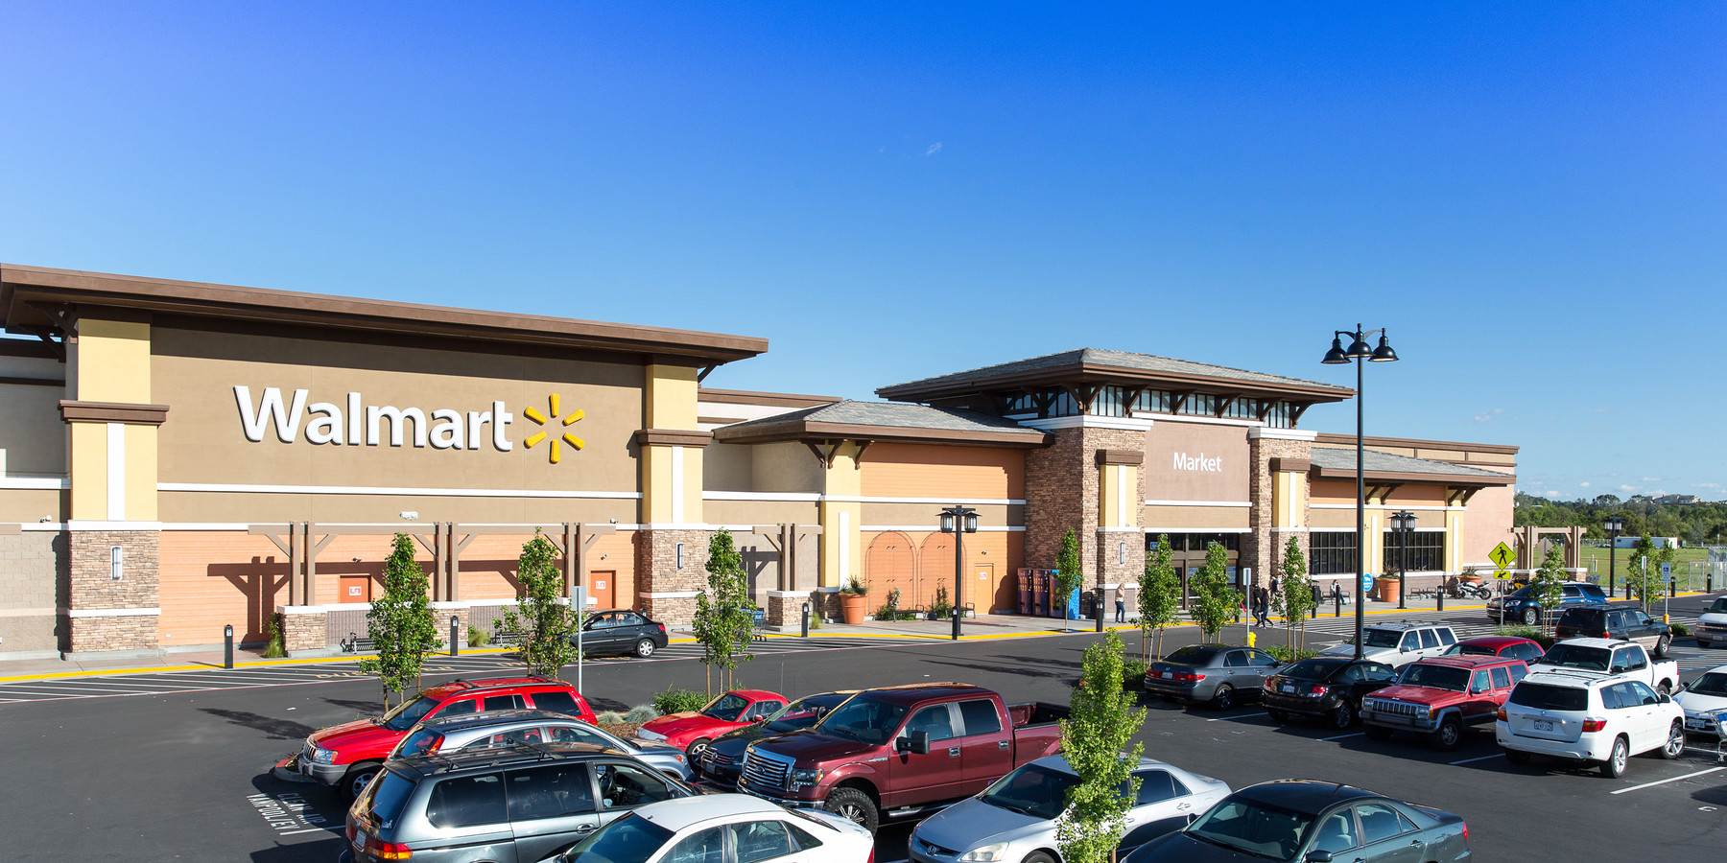
OPPORTUNITY
Turnover
Overall turnover: 135%
Overnight stockers: 160%
Cashiers: 130%
Some exacerbating factors of turnover:
Students
Transfers out of the store
Affluent teens
Store of the Community profile
Majority living in $100k homes with no children
Many affluent adults
Average age in the area is 60 years old
Notes:
The topic we decided to choose for our problem is turnover.
Within the first week of the internship program, the turnover rate for our store was 135% (the goal for every Walmart store is 80%).
The top 2 shifts that had the highest turnover were overnights (160%) and cashier (130%).
Some factors that could contribute to the high turnover are:
Students looking for seasonal jobs
Lack of employed minors
Transfers

Slide 3
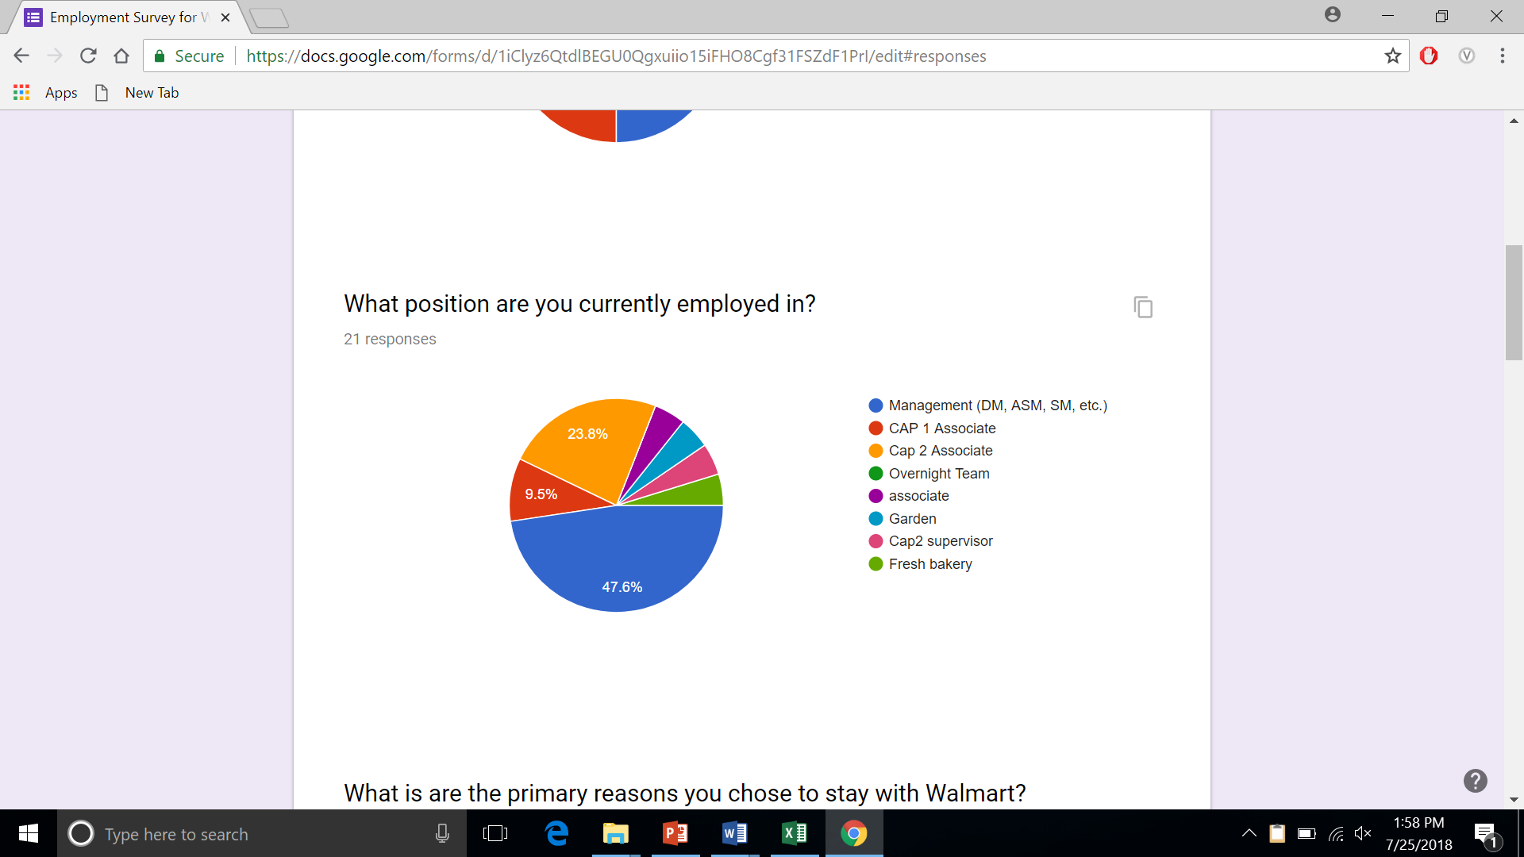
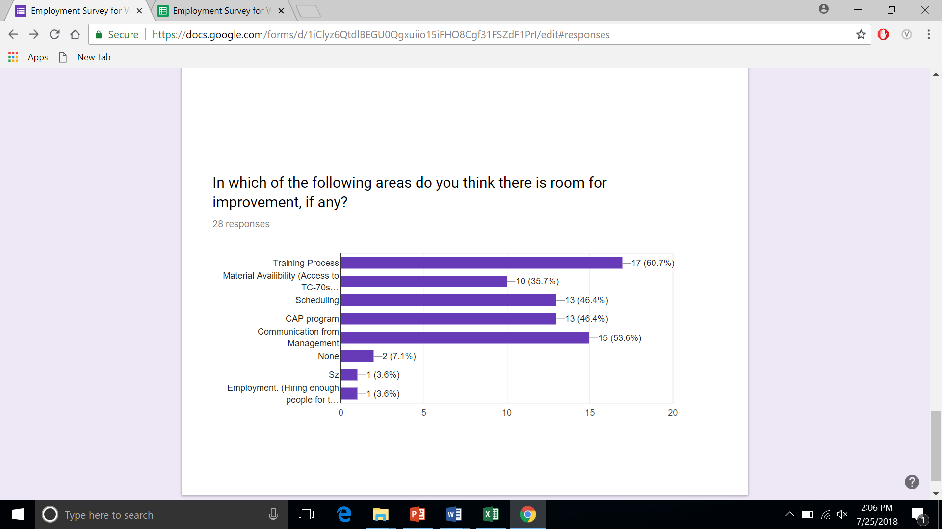
SURVEY
We conducted a survey about the associate’s experience at Walmart
Notes:
How Long have you been with Walmart?
Turnover is highly concentrated in first year of employment.
What was the primary reason you stayed with Walmart?
56% said potential for advancement. Other options were <15% each, including starting pay.
I am comfortable using the open door policy
Only 60% comfortable. Newer associates are wary of using open door
Where is there room for improvement?
Newer associates claimed training process/material availability, while older associates said scheduling/communication from management needed the most work.

Slide 4
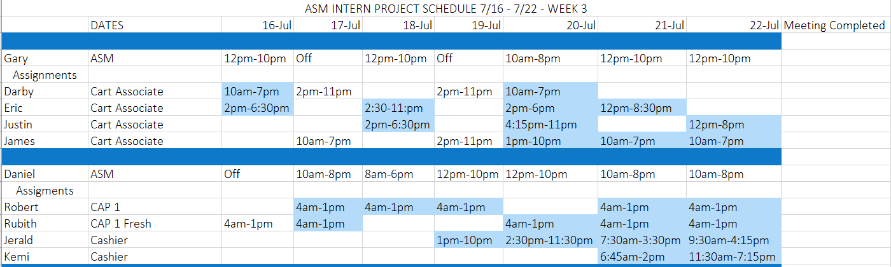
OUR PLAN AND IMPLEMENTATION
Plan
ASM meetings
Increase communication
Talking points
Hobbies
Training
Company
Implementation
Linked new hires schedules with ASM
Reminders
Plan It
Forms

Slide 5
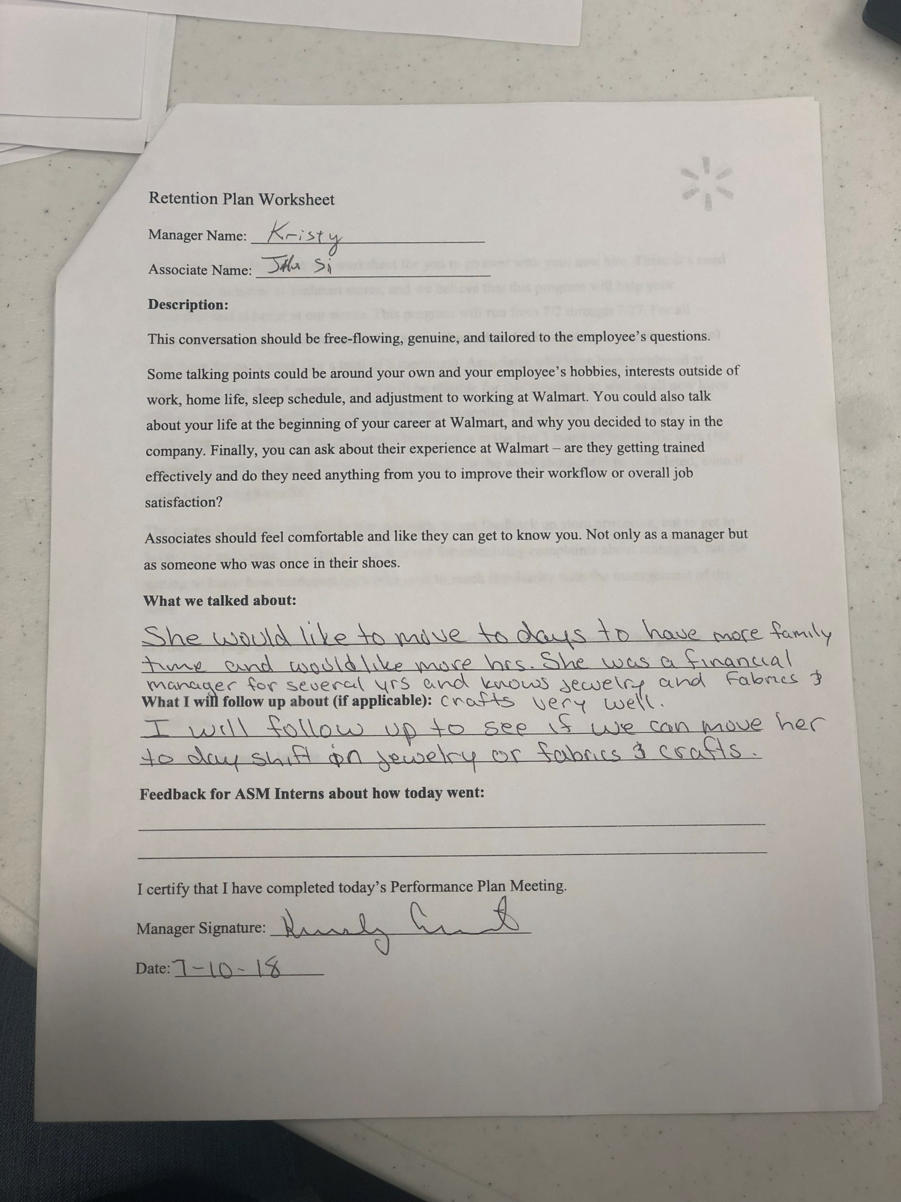
RESULTS AND FEEDBACK
Implementation began five weeks ago
First and second week
91% of ASMs completed meetings
7 ASMs
30 associates
ASMS enjoyed meeting with their associates
Plan could be developed into future One Best Way
Talked about training and placement oversights, as well as personal life
Notes:
Turnover
Overnights: 120%
Cashiers: 114%

Slide 6

RECOMMENDATIONS
Associates that just got promoted into new positions
Meeting talking points
Change to once every two weeks
Better accountability system for ASMs
Notes:
Need to include associates that just got promoted into new positions
associate that just got promoted to DM position from cap two. having trouble with the transition and could benefit from the meetings as they help clear confusion
Have a better outlined talking point for each week meeting
Consider changing meeting times to once every 2 weeks.
this is to make the meetings less repetitive that way they stay beneficial. It is also to ease the stress of the ASM’s having to figure out a way to meet with all the associates weekly with their busy schedules. by slowing the rate of the meetings the ASM’s are able to put better focus on the ones they have to meet with.
Better accountability system for ASMs
with the more busy ASM’s having them get the meetings done was a little more difficult. creating a better accountability system for the ASM’s to make sure that they are getting done would be very beneficial for our plan. whether it be in the PlanIt app or another way.

Slide 7
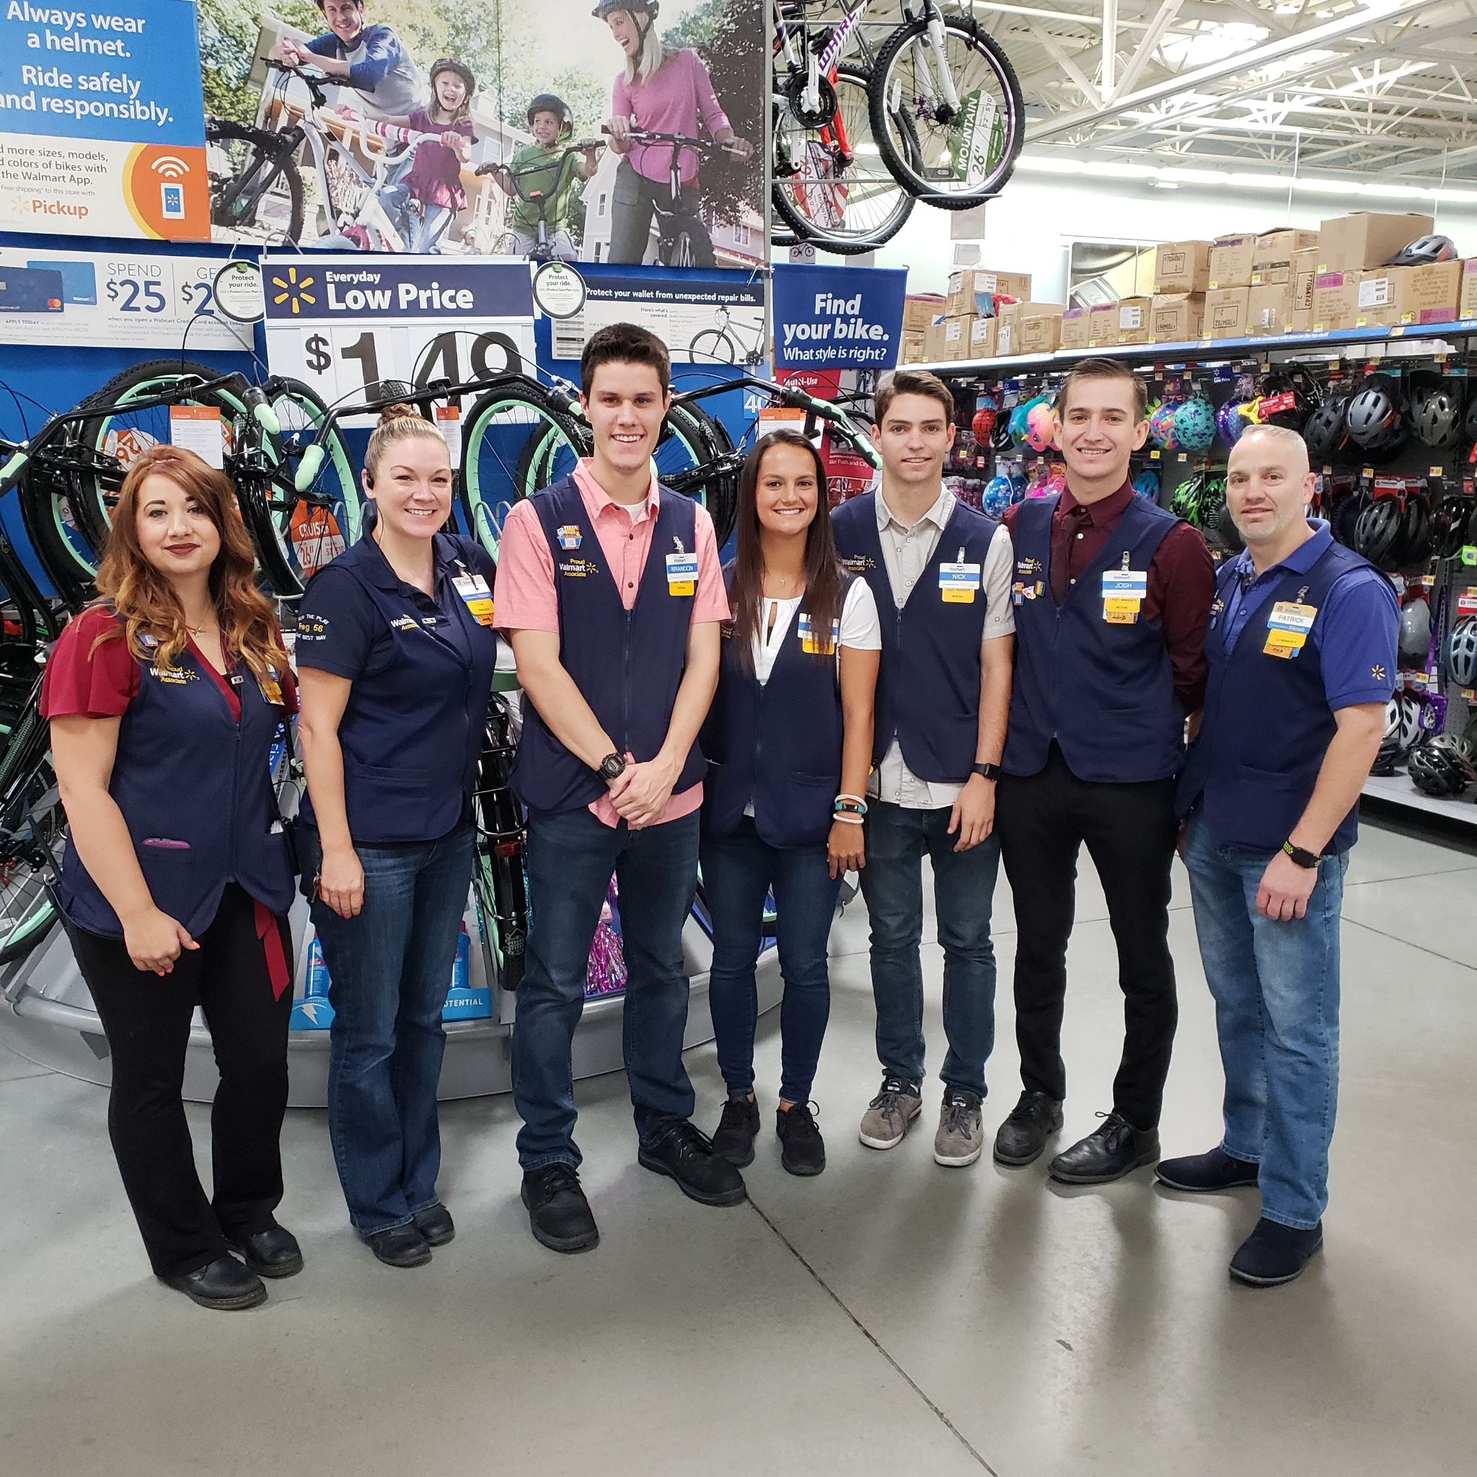
THANK YOU
Notes:
WRAP UP
The Turnover project that we have bee

Slide 8
QUESTIONS?

